Slide 1
FRC Kitbot Programming prekickoff - 2026
Team 4533 Phoenix 10 JANUARY 2026

Slide 2
Presentation Overview
This is based on 2025 Kitbot code and 2025 WPILIB
Expect 2026 Kitbot code and 2026 WPILIB posted by FRC soon
We’ll go over:
Reference Sources
Setting up coding environment
Steps to compile
Steps to deploy
Some test/troubleshoot info

Slide 3
Important Resources
REFERENCE DOCS:
Search ”FRC Control System” or visit https://docs.wpilib.org/en/stable/docs/zero-to-robot/introduction.html Notice left column there has so much info..
But go through steps 2 thru 4 on that page as they also are very helpful.
Kitbot programming guide PDF along with example code in zip file: https://www.firstinspires.org/resources/library/frc/kitbot
We’ll refer to that PDF as the Kitbot Java PDF. There is also a Kitbot PDF related to building the actual robot hardware found on the Kitbot order page.

Slide 4
Development Environment
Java is most popular Coding Language in FRC
Popular = examples are easier to find
Easier to get help with JAVA from other teams or FSA
some teams use Python or C++ or Labview instead of Java
VScode is the usual editor
also known as an IDE (Integrated Development Environment)
Gradle is behind the scene to do the build and deployment
Git is used for revision control and coding sharing

Slide 5
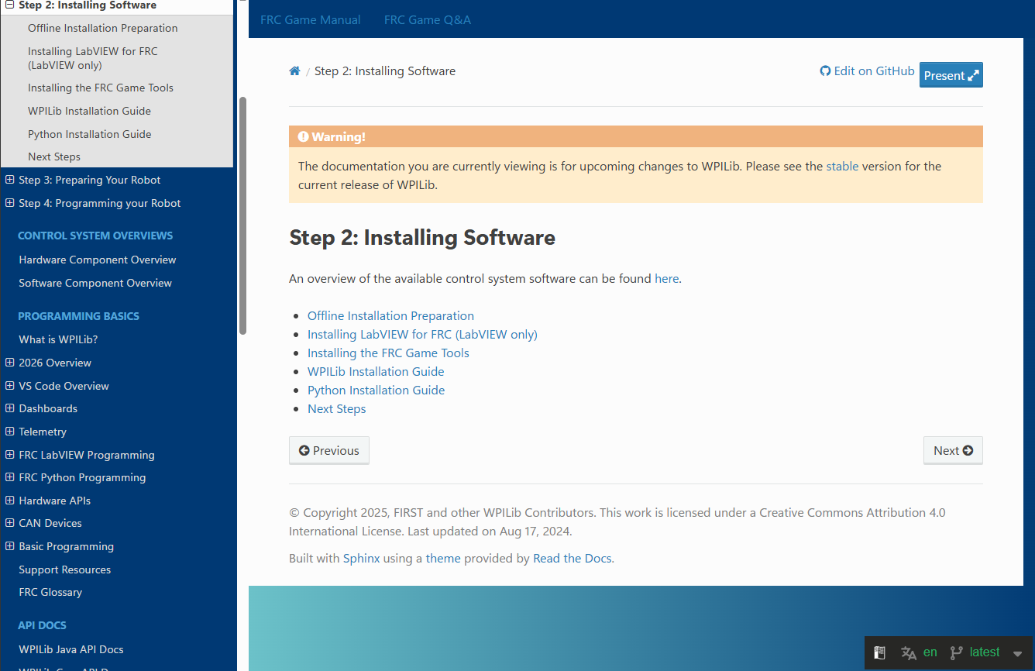
Set up environment – follow suggestions
Search FRC Control System or visit
https://docs.wpilib.org/en/latest/docs/zero-to-robot/step-2/index.html
Make sure says Latest Here !

Slide 6
Install tips for Programming Environment
Window Laptop for now (you will need drivestation, etc)
First Install the FRC Game Tools
Brings along drivestation and Roborio image tool
Second Install WPILib
Brings along VS Code
Install Rev Client if using Sparks (not needed until time to deploy or setup CAN IDs)
Install CTR Phoenix tool if using Krakens or other CTR devices
Install Git for revision control

Slide 7
Install tips continued
Decide where to keep your code on your computer BUT DO NOT store code on Onedrive, it will not compile correctly And will bite you at competition for sure
example: C:\FRC might be good folder to create and put your projects in
Once you’ve downloaded one time, you will understand how to save it all off to Flash drive for multiple computer’s use
Linux PC can be used for writing code, just Drivestation won’t run there this year (maybe next year?)

Slide 8
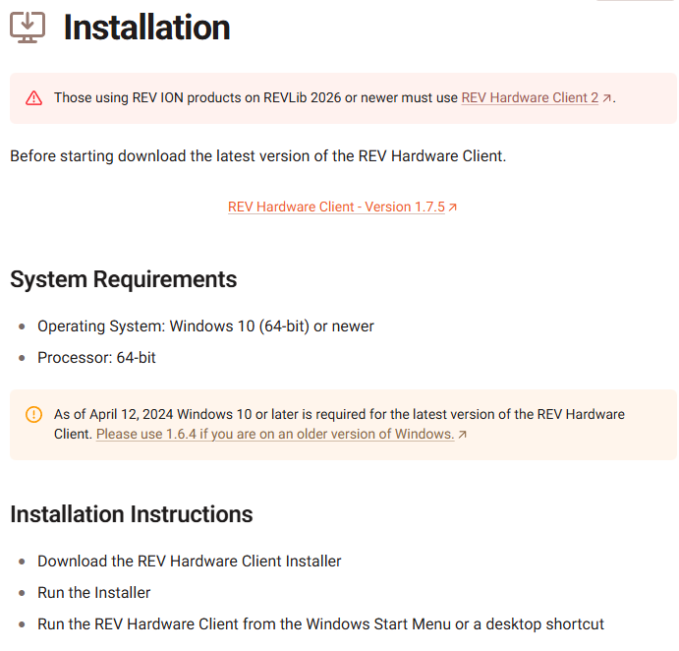
Install Rev Hardware client
Follow instructions and allow to update: https://docs.revrobotics.com/rev-hardware-client/gs/install
This allows Spark firmware and more to get updated, and also to assign CAN IDs.
If using CTR hardware instead of REVrobotics, you would use CTR Phoenix Tuner, similar procedure

Slide 9
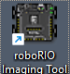
After setting up Development Environment, you then “Image the RoboRio”
Visit https://docs.wpilib.org/en/stable/docs/zero-to-robot/step-3/index.html
Walks you through Imaging your RoboRio and setting up your radio.
Programmers need to know how to do this.
Roborio Imaging Tool provides a way to update the Roborio firmware if needed,
But almost always you will need to update the Roborio Image from year to year, and at competition it will slow you down if you did not do this at it is required to be up to date, as is all firmwares on all robot devices cabaple of firmware updates.

Slide 10
Kitbot Programming starting point
visit https://www.firstinspires.org/resources/library/frc/kitbot
download the zip file of code for that bot (might also be on github)
open up file explorer , find that C:\FRC folder or make one
and again right click and create folder for Kitbot
Drag in the content of the Zip file
Launch VS

Slide 11
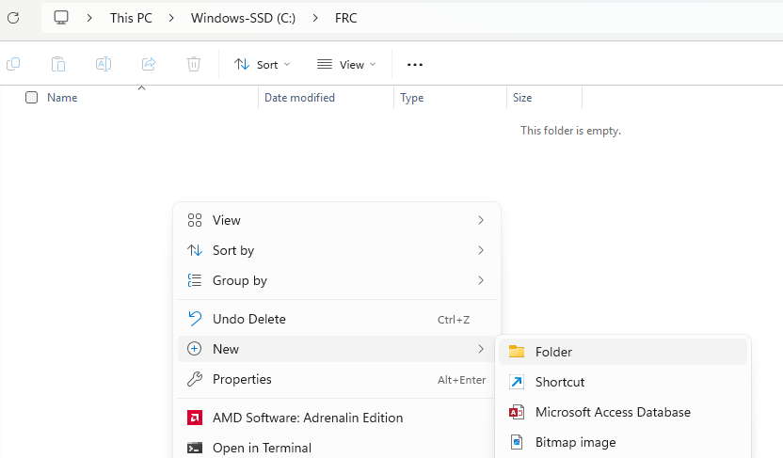

Slide 12
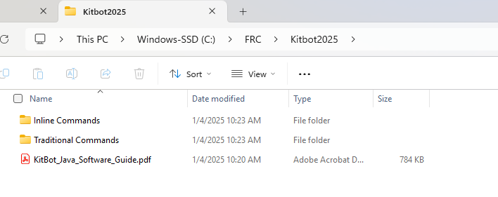
Zipfile had 2 separate Code directories, you can rename or use as is and PDF file is Guide, good reference Start with Traditional Commands folder, probably best to copy directory and rename the copied directory as your TestBot for starting out

Slide 13
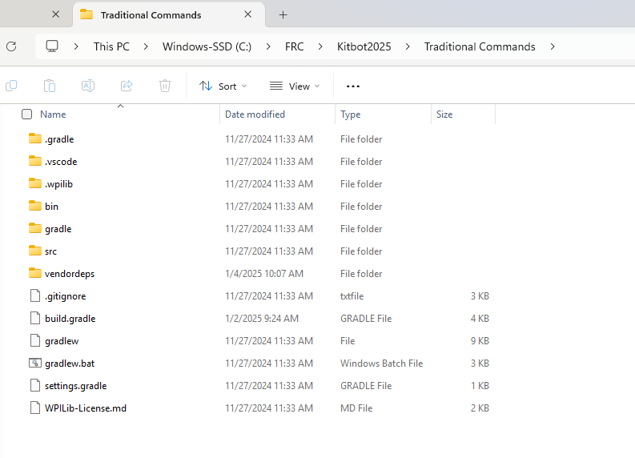
Next open up vscode

Slide 14
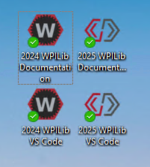
Launch VS Code
Icons from previous installs may appear along with Documentation links, use the Icon with year that makes sense

Slide 15
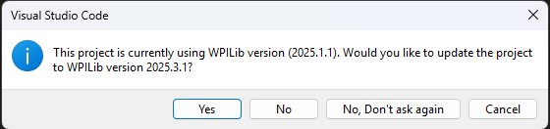
First Time you open existing or Old Project
Feel free to say no and see if it still builds. You can always close it and it will prompt you again if you said no.

Slide 16
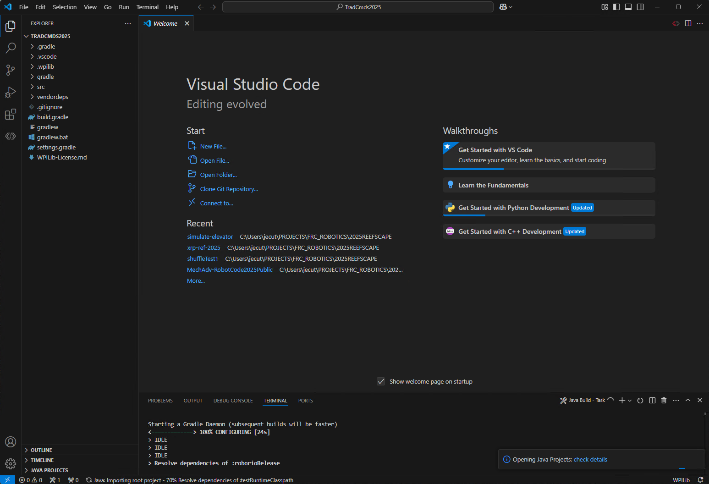
First time you open, it builds, be patient

Slide 17
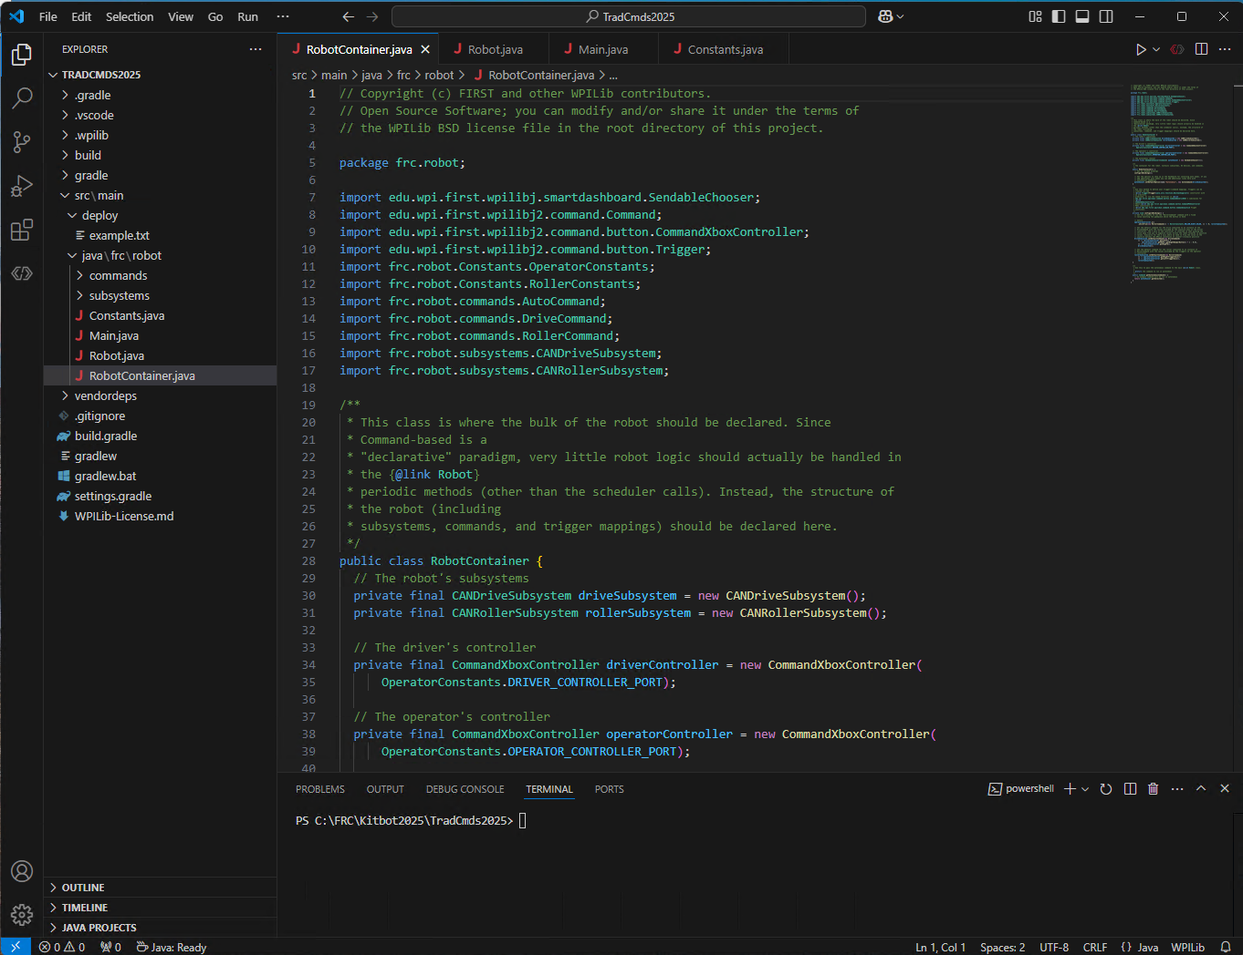
Java code found under src\main\java\frc\robot

Slide 18
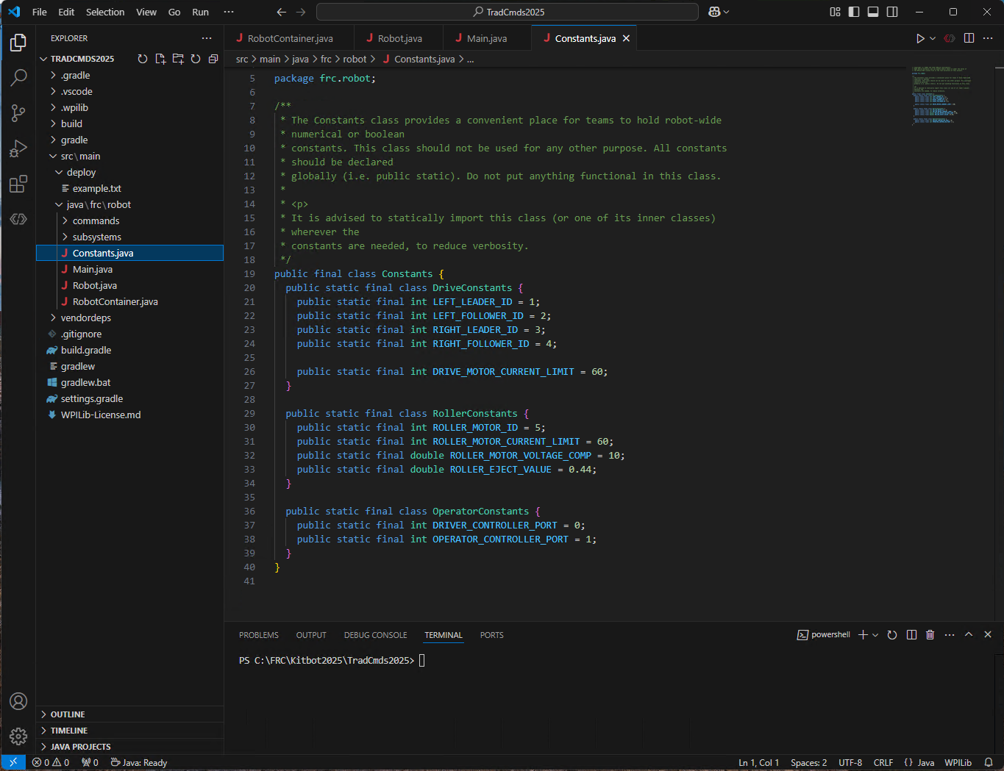
Constants.java file initializes ID #’s related to CAN ID’s of Motor Controllers Values are up to you, but must agree with Controllers
ID’s here

Slide 19
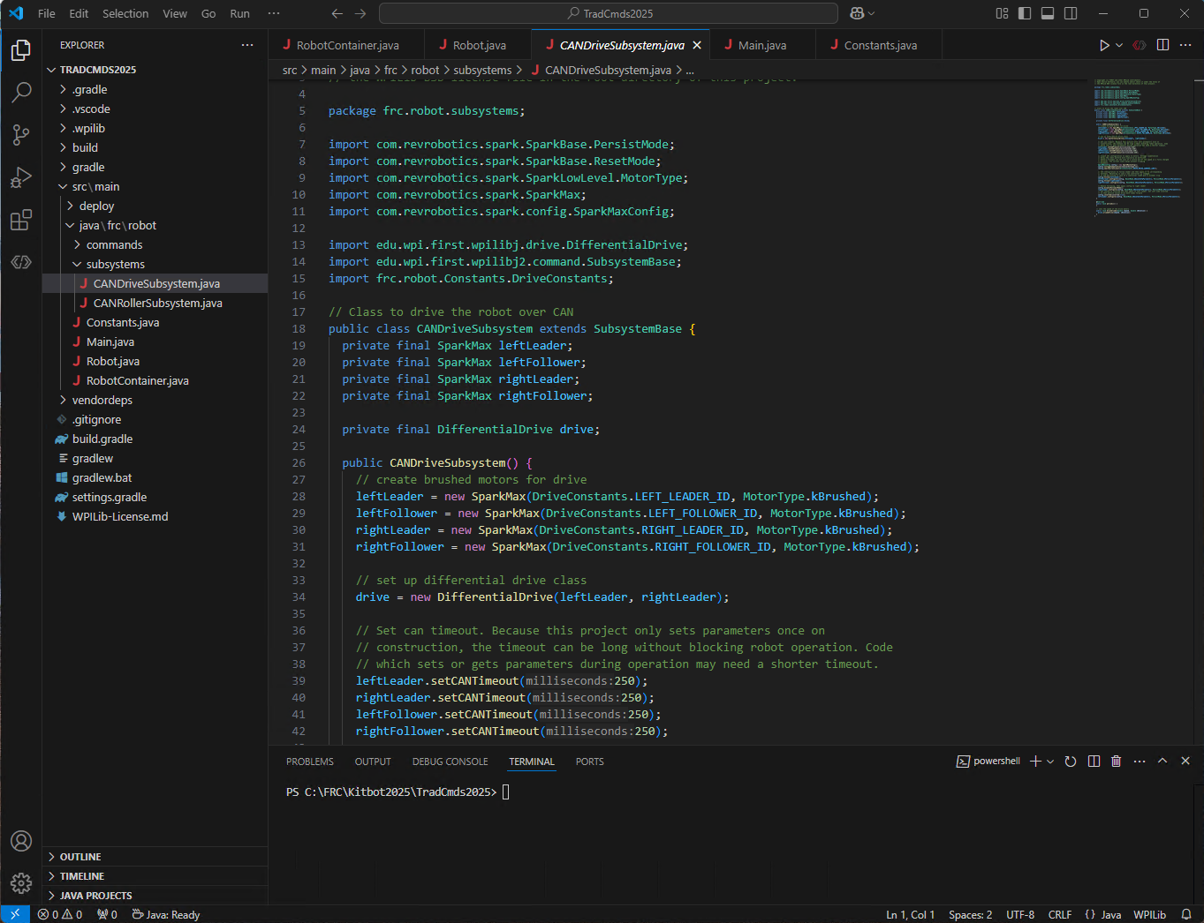
Notice those ID’s get used in subsystems CANDriveSubsystem.java
ID’s here

Slide 20
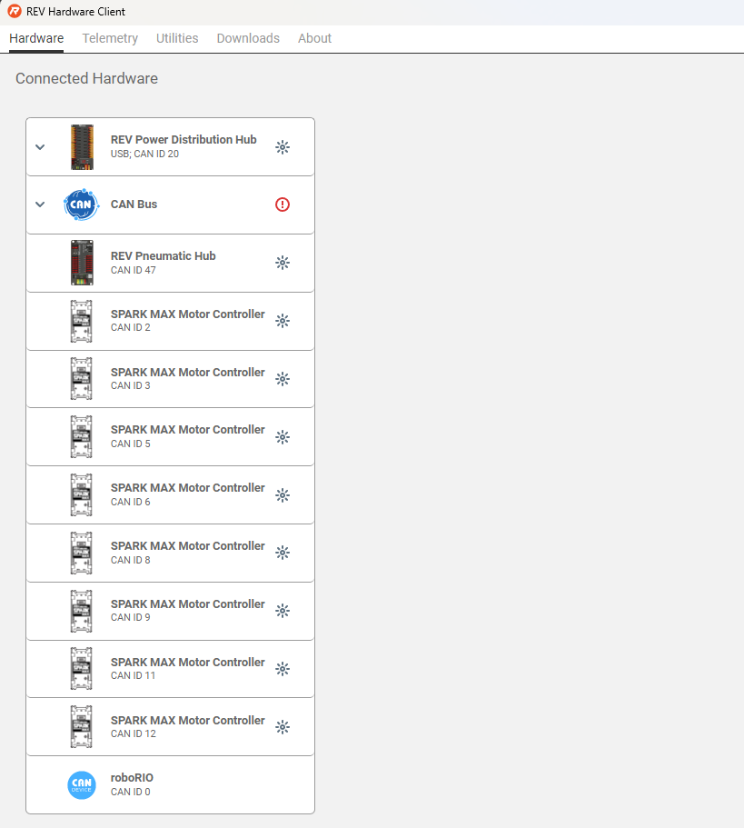
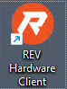
Set hardware to agree with Software
First time you run REV Client,
You will see list of CAN Devices, And you can ‘blink’ an individual device to find it on the Robot.
You should make sure all CAN ID’s are unique.
Set the ID’s inside REV client to agree with actual device’s function on the robot.
If they would conflict or be duplicate, move some to higher numbers. Keep in the range 1 to 62 unless you know otherwise. Try not to use ID 0 or 1 as it may conflict with Power Distribution or Pneumatics controller.
See also section 3.4 of Kitbot Java PDF
Also recommend Max Current 30A not 60A.

Slide 21
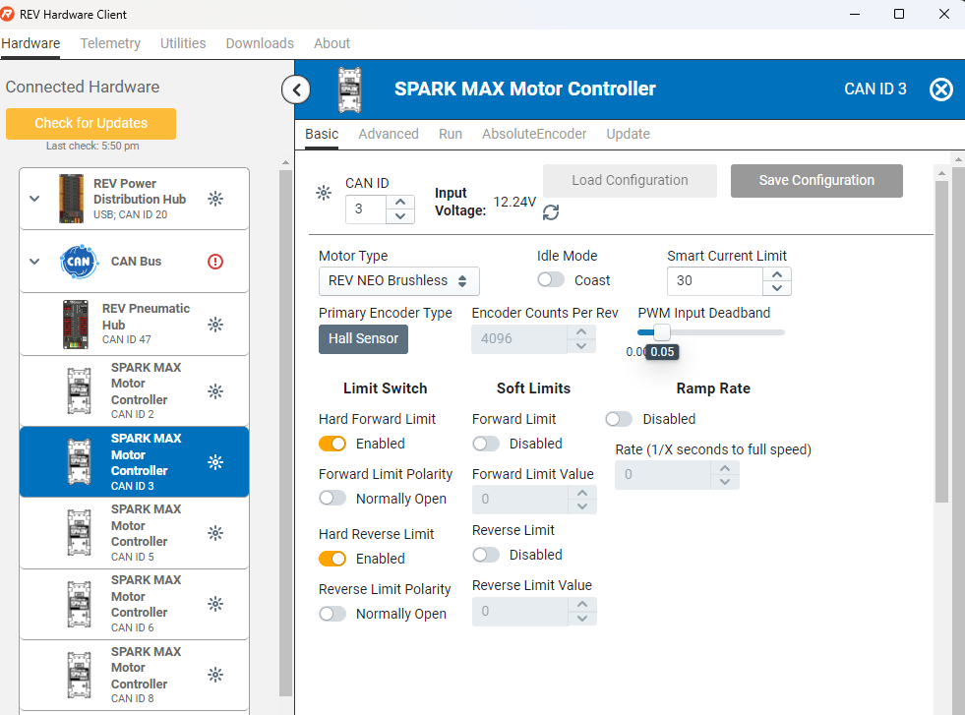
Here is where you actually set the CAN ID AND there is Update tab to update firmware You see we set Current limit to 30A, but that can be overridden in software, set both places to 30A.

Slide 22
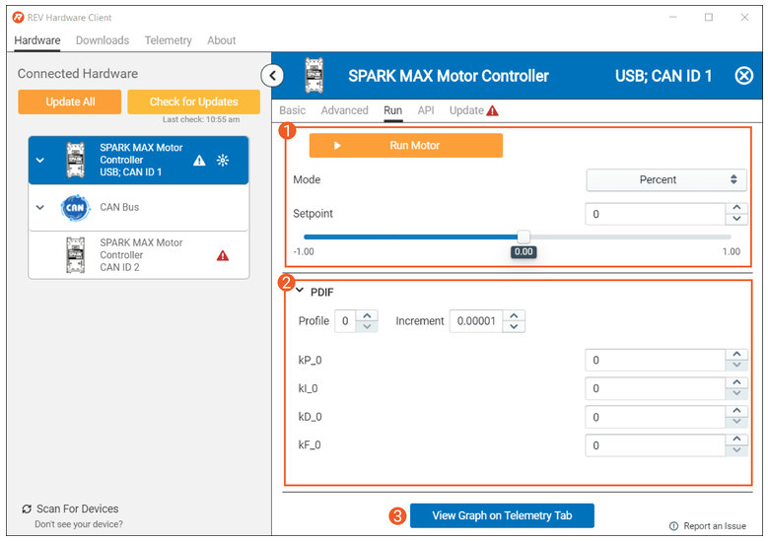
Notice Red Triangle near the Update tab, it wants Firmware update. When you select a Spark Max you can choose Run and move the slider/click run to have motor spin. BUT keep hands clear and warn people. Always have robot on blocks off floor in case you are spinning the wrong motor. Also keep bumpers or poolnoodle on perimeter of robot to guard against running it into objects.

Slide 23
CAN BUS ISSUES:
If you don’t see all of the devices, you likely have one or more issues with your CAN bus wiring:
Verify that your CAN bus starts with the roboRIO and ends the built in terminator of a Power Distribution Hub or Power Distribution Panel (with the termination set to On using the appropriate jumper or switch).
Check that your CAN bus connections all match yellow-yellow and green-green.
Check that all CAN wire connections are secure to each other and that the connectors are securely installed in each SPARK Max.
If you’re still having trouble, moving the USB connection around to different devices and seeing what each device can “see” on the bus can help pinpoint the location of an issue.
You can also disconnect a single SPARK from CAN bus and after a power cycle, use the USB cable to ‘talk’ to just that one SPARK by plugging into it directly.

Slide 24
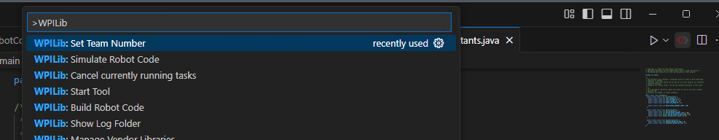
Build the Code
First set the team # (normally you do this when you build a new project), click the Red/Gray <<>> at top right and start typing “Set Team Number”, you should get option to set team to your team#.
Leading Zeros are not allowed

Slide 25
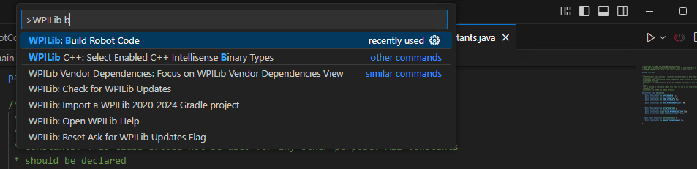
Build Continued 1
Click the Red Gray <<>> again and choose Build Robot Code

Slide 26
Time to Deploy
But first words of safety: WARNING
Make sure area safe to operate the robot.
Have bumpers or pool noodle attached to edges of robot to lessen any impacts.
It will go the wrong way at first.
It will need to probably be slowed down, do that in code.
Remember the spacebar is E-stop (Emergency Stop) and the Enter is enable/disable. After an E-stop you may have to power cycle robot.

Slide 27
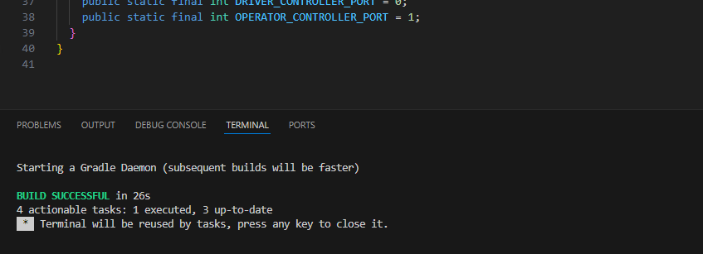
Deploy Robot Code
Click the Red / Gray <<>> again and choose Deploy to Robot
You should see Build Successful as below after about 30 seconds,
Subsequent builds happen faster.

Slide 28
Game Controllers
Xbox Controllers are the most popular, possibly followed by Logitech F310 type controllers. The code is set up to use the Xbox controller class.
There are 2 controllers expected, one for Driver and one for the Operator.
Driver will move the robot, and the Operator will operate the roller.
If a team wants to use the Logitech F310 game controllers, they will appear like Xbox controllers to the WPILib software if they are configured in the correct mode. To set up the Logitech controllers, check that the switch on the back of the controller is set the ‘X’ setting. Then when using the controller, make sure the LED next to the Mode button is off; if it is on press the Mode button to toggle it. When the Mode light is on, the controller swaps the function of the left Analog stick and the D-pad.
Those extra buttons can cause robot downtime during competition so train the drive team on them or find a way for them to not be pressed.

Slide 29
More details on Code Layout
Subsystems
For the 2025 KitBot we have 5 motors that make up 2 subsystems, the Drivetrain, and the Roller. The 4 motors in the drivetrain always need to be working together to move the robot around the field and the Roller motor must spin to manipulate Pipes.
Two subsystem files: Drive and Roller in subsystems folder
The general rule of thumb on how to break up subsystems is to think about what actions, or commands, you might have to control the subsystems.
Perhaps you will run the intake while moving the arm or wrist? Err towards more smaller subsystems; you can always make commands that require multiple subsystems but if you end up wanting separate commands to control a single subsystem at the same time, you’ll have to refactor the subsystem to split it up. See the Kitbot Java PDF as some of this mentioned there.

Slide 30
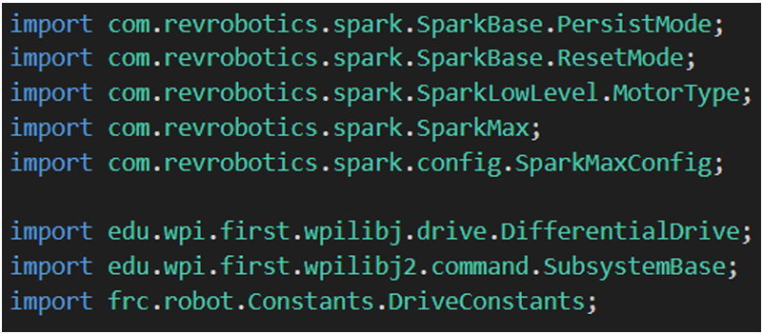
Imports
Import section of code declares what other classes or packages we need to reference within this code (imports). A common practice is to add imports as you go.
The first group of imports in this subsystem is from the REV Robotics library for the Spark MAXs.
The second group is WPILib classes (one for the type of drivetrain on the robot and one for subsystems) and the DriveConstants section of the Constants file from this project.

Slide 31
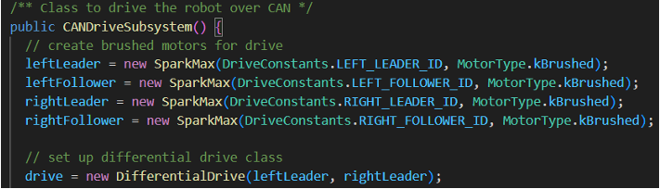
Constructors
The next section is the constructor. In the first part of the constructor we initialize any variables contained in the subsystem.
In the case of our drivetrain, we initialize the 4 motor controllers and add one controller for each side into a WPILib DifferentialDrive object which describes the whole drivetrain.
The remainder of the constructor (not pictured) sets up the SparkMAXs for the drivetrain. One motor on each side is set as a follower and directed to follow the leader, then the leader motors are configured with some additional details.

Slide 32
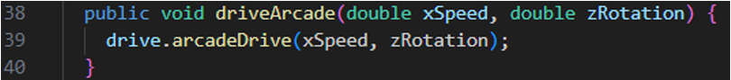
Methods
The remainder of the subsystem class is methods. Here we define any methods that commands may need to call to get status from or perform actions on the subsystem. For our simple drivetrain, the only method we need is the driveArcade method which simply passes the parameters through to the same method on the DifferentialDrive object.

Slide 33
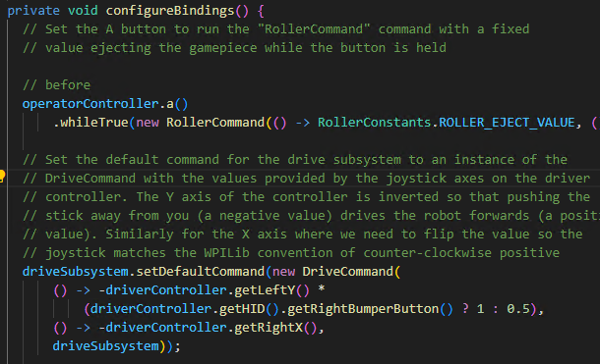
Actual Drive Control
RobotContainer.java’s ConfigureBindings sets up what the Xbox controller does

Slide 34
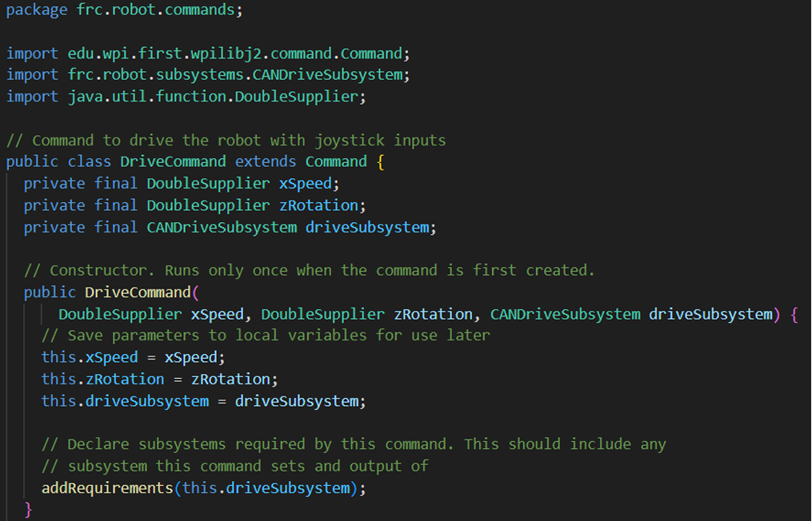
Command DriveCommand does the driving
Constructor stores parameters into Class variables for later.
The addRequirements will make sure subsystem is available

Slide 35
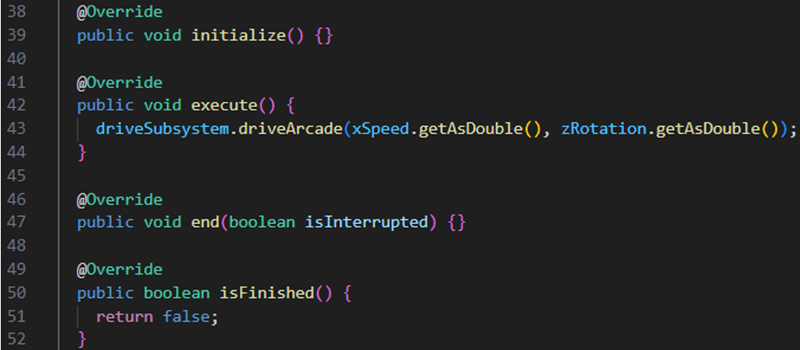
Command DriveCommand does the driving
In the execute() method, we call the driveArcade method from the drive subsystem which tells the motors to drive such that the robot moves according to the joystick inputs.

Slide 36
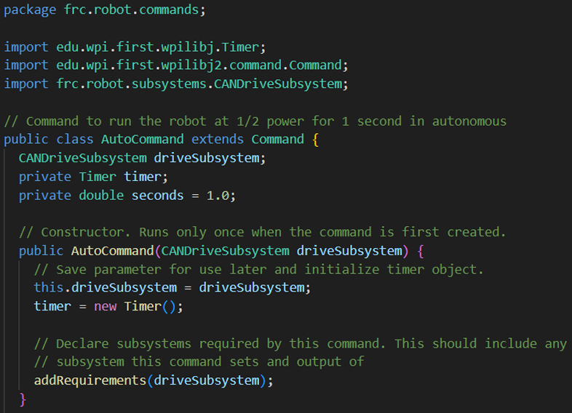
Autonomous – drive forward 1 second
Imports and Constructor
Class sets up two variables and a method

Slide 37
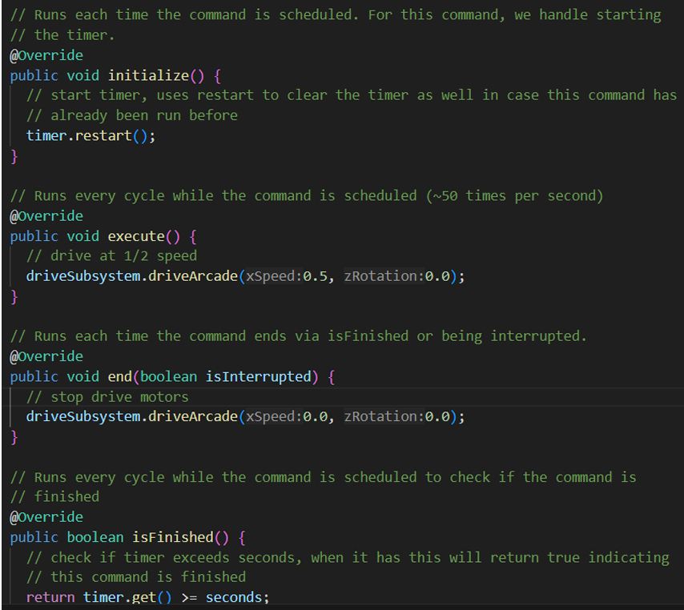
AutoCommand Methods
Initialize: Start the timer.
Execute: Sets the drive motors to drive forward.
End: Stop the timer and stop the drive subsystem.
IsFinished: Returns true when the timer exceeds 1 second.

Slide 38
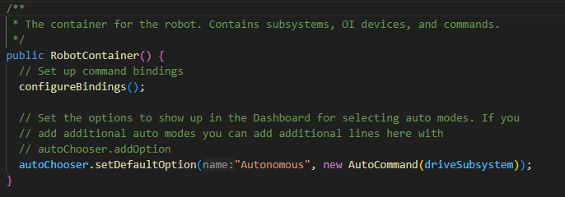
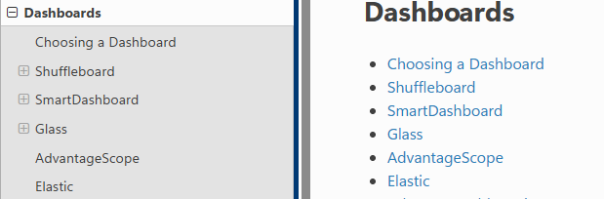
Enable/Disable AutoCommand
RobotContainer.java
autoChooser is a pulldown that can appear on your drivestation’s dashboard such as Shuffleboard.
Read about Dashboards

Slide 39
More on Autonomy
Refer to the Kitbot JAVA PDF to learn more about Autocommands
And also the Command Based Programming section of Wpilib docs.

Slide 40
Why Git ? For Revision Control
Once you add and commit, code is on github forever
Allows you to revert back before that accidental wrong edit
Allows ‘branching’ for adding a feature while main baseline still available
Allows other team to look at your code to assist
Allows you to share your code to assist other teams

Slide 41
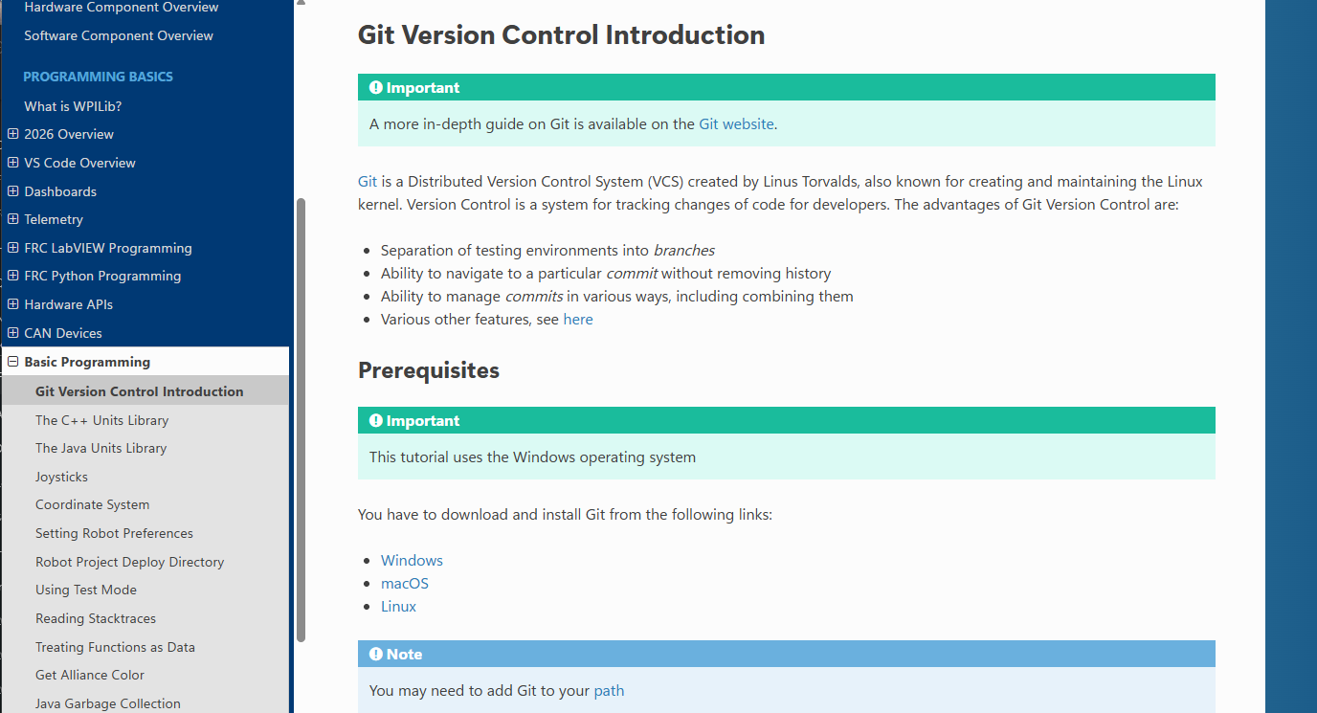
Install GIT for version Control https://docs.wpilib.org/en/stable/docs/software/basic-programming/git-getting-started.html Lots of info on the FRC page, follow those instructions

Slide 42
Git Vocabulary
Git concepts and commands:
Repository: the data structure of your code, including a .git folder in the root directory
Clone: retrieve a local copy of a repository to modify
Fork: duplicate a pre-existing repository to modify, and to compare against the original
Branch: a means of grouping a set of commits. Each branch has a unique history. This is primarily used for separating development and stable branches
Add: Queues up some changes
Commit: a particular saved state of the repository, which includes all files and additions
Push: update the remote repository with your local changes
Pull: update your local repository with the remote changes
Merge: combine various changes from different branches/commits/forks into a single history
VS Code extension so it’s built into VS code

Slide 43
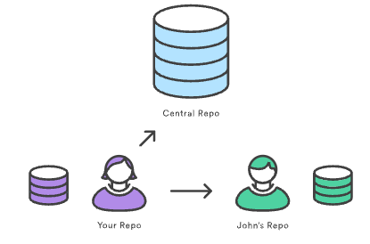
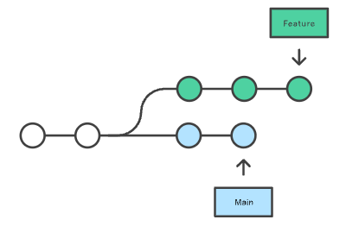
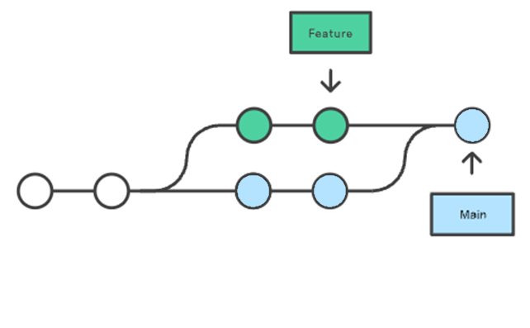
More Git
Tutorials on Git
https://git-scm.com/learn
https://www.atlassian.com/git/tutorials
https://docs.github.com/en/get-started/start-your-journey/hello-world

Slide 44
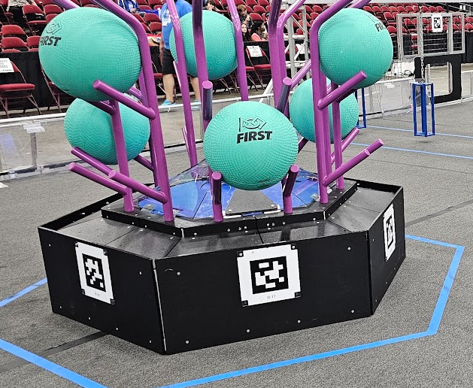
Vision – very helpful for automous period
Photonvision runs on Raspberry Pi with webcam to help locate your robot on field https://photonvision.org/
Limelight is all in one solution for locating robot on field.
https://docs.wpilib.org/en/stable/docs/software/vision-processing/apriltag/index.html
Once your robot knows where it is, autonomy becomes easier
https://www.youtube.com/@0ToAuto

Slide 45
Learn Java and more
https://learn.microsoft.com/en-us/shows/java-for-beginners/
Codeacademy
Coders need to know the hardware they control: https://docs.wpilib.org/en/stable/docs/controls-overviews/control-system-hardware.html

Slide 46
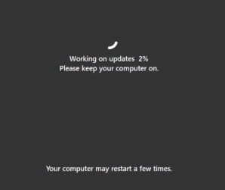
Competition gotchas
BEFORE Leaving for competition:
Make sure firmware updated for all motor
controllers (use REV client or CTR phoenix tuner)
Make sure your code compiled with latest WPIlib
Make sure Roborio has latest firmware and Image
Visit here https://github.com/wpilibsuite/allwpilib/releases
Update Laptop software, but once updated, turn off updates for duration of competition, as that ‘blank screen updating’ during your scheduled competition does happen.

Slide 47
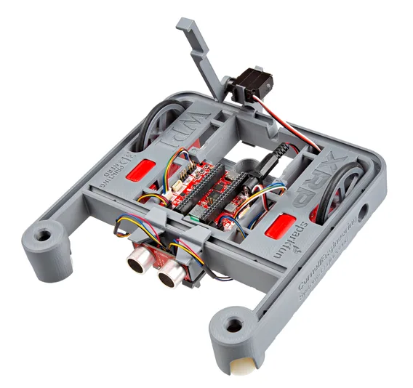
XRP robot is tiny robot using same code
Uses same WPIlib code
Great intro to code for new coders
Helps understand game controller and motors
https://docs.wpilib.org/en/stable/docs/xrp-robot/index.html

Slide 48
Other References
Team 254 Slides https://drive.google.com/drive/folders/1tZ6xdn-xzFpcAzW3VB5ttzQwuhUmvPJB?usp=sharing
Kitbot 2025 https://firstfrc.blob.core.windows.net/frc2025/KitBot/KitBotBuildInstructions.pdf
And the Kitbot Java PDF from the kitbot java code zipfile
https://frcteam3255.github.io/FRC-Java-Tutorial/
FirstSC slack for updates on any South Carolina specific coding collaborations

Slide 49
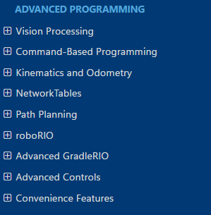
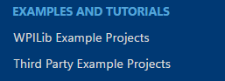
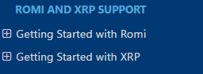
More
There is so much at the docs.wpilib.org site

